Slide 1
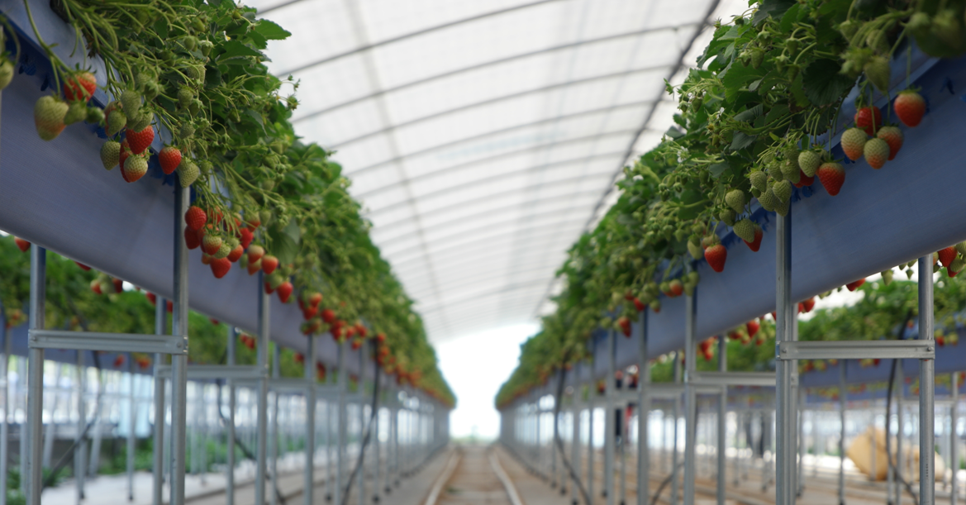
Strawberries,
the Beginning of
Smart Farming
Good Farmers’ Group Inc.
40-32, Yool-ri 2 Gil, Cheongri-myeon, Sangju-shi, North Gyeongsang Province
www.strawberrygarden.co.kr
Confidential

Slide 2
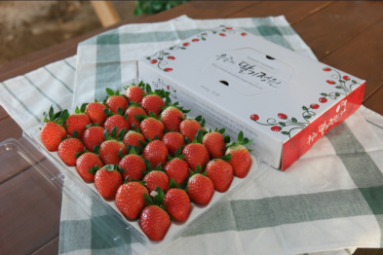
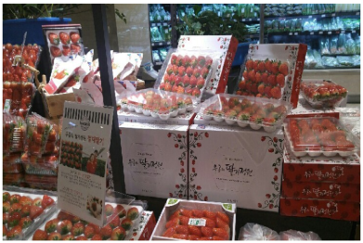
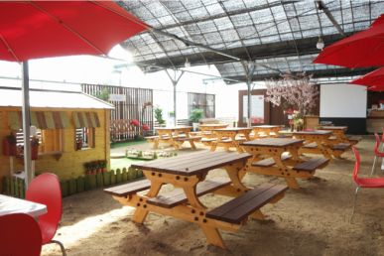
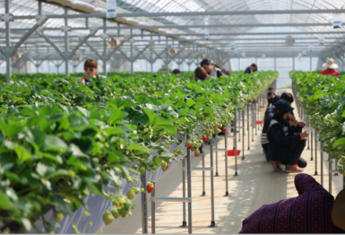
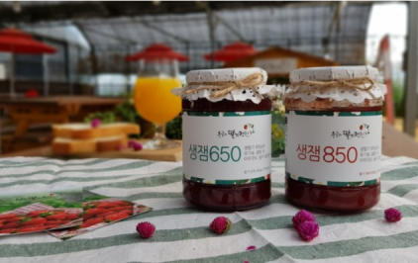
Farm Overview
|A farmers’ farm where they grow best strawberries under the spirit of “Woo Gong E Sahn”, meaning “No matter how difficult a thing is, as long as we persist, we shall definitely succeed.”
Overview of
‘Woo-Gong’ sStrawberry Garden’
Overview of
Good Farmers’ Group
Located in Sangju city, Gyeongbuk province
Founded in 2014 by former LG and SAMSUNG mgmts.
Facilities (All adapted Smart farm solutions)
- Cultivation and Seedling Area 7,500m²
- Experience zone 400m²
- Work house 400m²
- Parking lot 700m²
Business Area
- Sales of fresh strawberry
- Offering PICKING AND EXPERIENCE program
- Sales of processed goods (strawberry jam)
Operate ‘Woo Gong’s Strawberry Garden’
- Seedlings, Cultivation, Farm tour, etc.
Develop & implement new agricultural business models (Joining Sangju Smart Farm Innovation Valley)
- FARM FRANCHISE
- LEASE business of smart farm complex
- Sales & Distribution of smart farm device and facilities
Educate and consult
- Greenhouse horticulture business
- Agricultural management
- 2-

Slide 3
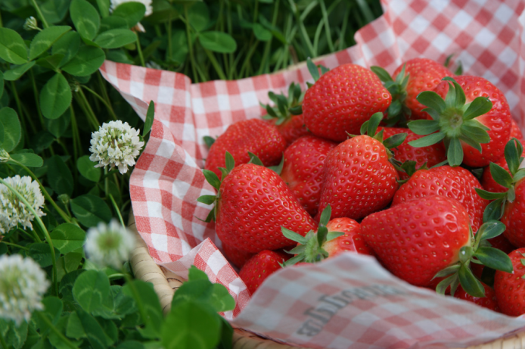
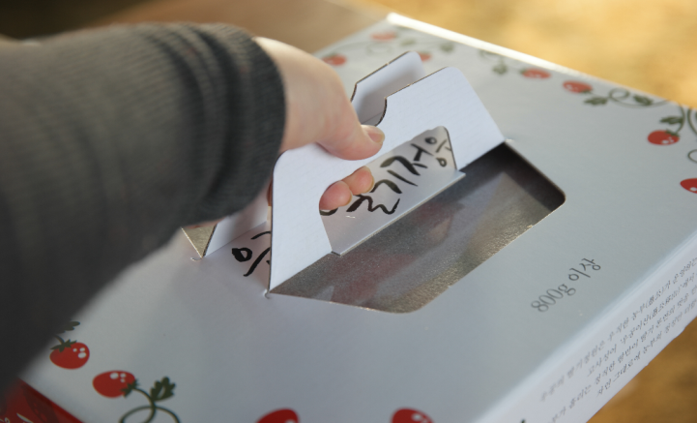
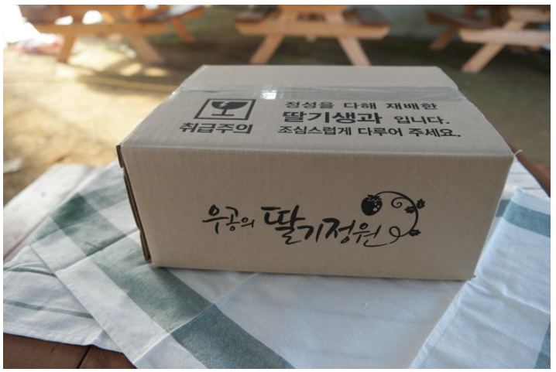
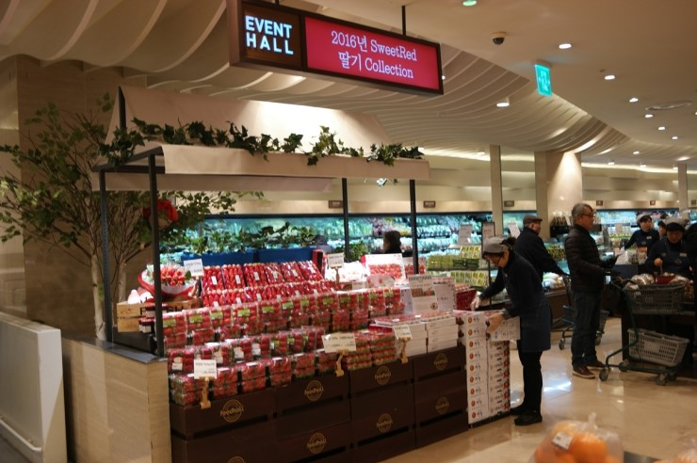
Sale of Fresh Fruit
Our farm sells high quality fresh fruit through direct transaction.
Delivery service takes up around 20% of our total revenue and 67% of our customers live in Seoul and metropolitan areas adjacent to the Capital of South Korea.
We take full advantage of the top tier distribution channels such as SahtGot Distribution and Strawberry Collection in AK Plaza Department Store.

Slide 4
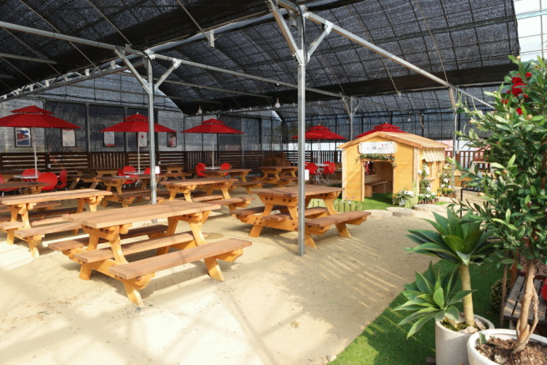
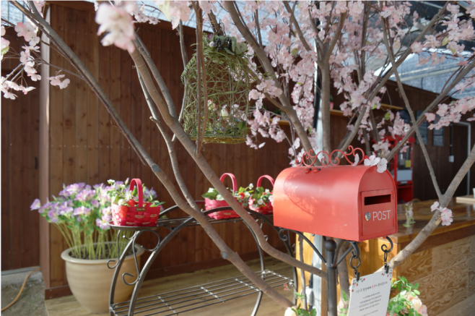
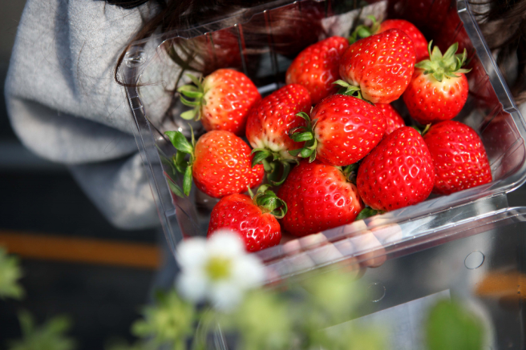
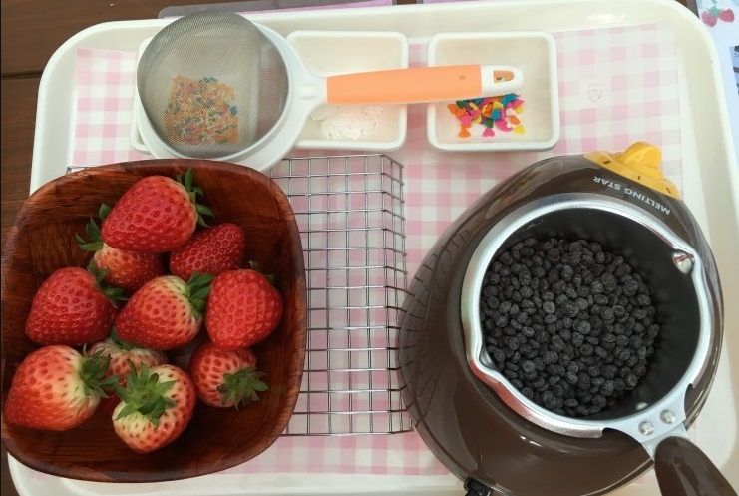
Strawberry Tour
We provide a differentiated tour package where you can eat, play and watch.
Weekdays: Group / Weekends: Family and individuals
Programs: Strawberry picking, cooking classes (Strawberry pondue, strawberry cake, strawberry soap, etc.)
Goal for year 2019 : 5,000 persons

Slide 5
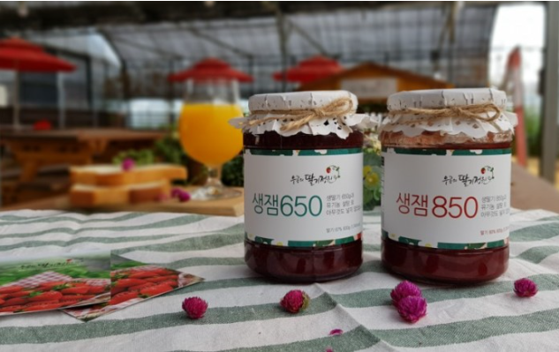
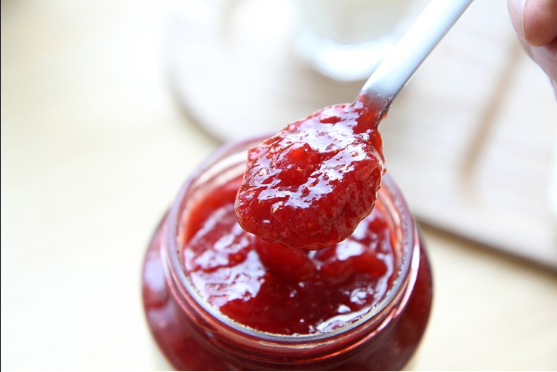
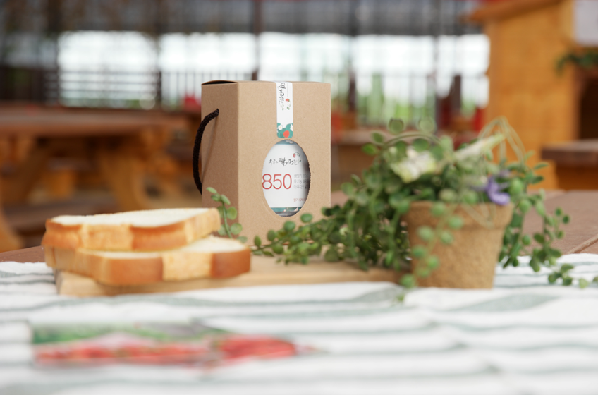
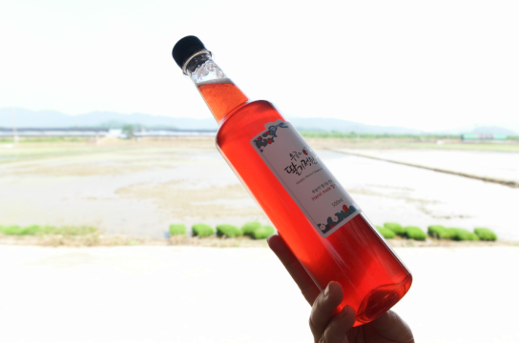
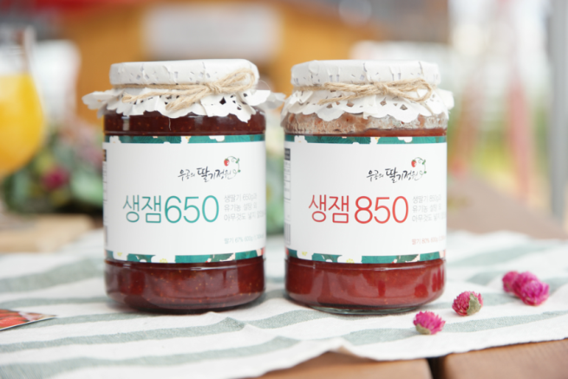
Sale of Processed Products
We make fresh strawberry jam slowly concentrated at a low temperature
Use fresh strawberries, not frozen ones for raw materials
Pure strawberry jam with no additives other than strawberry 67% and organic sugar 33%
Strawberries get concentrated slowly at a low temperature without coagulants, boasting original texture and smell of fresh strawberries

Slide 6
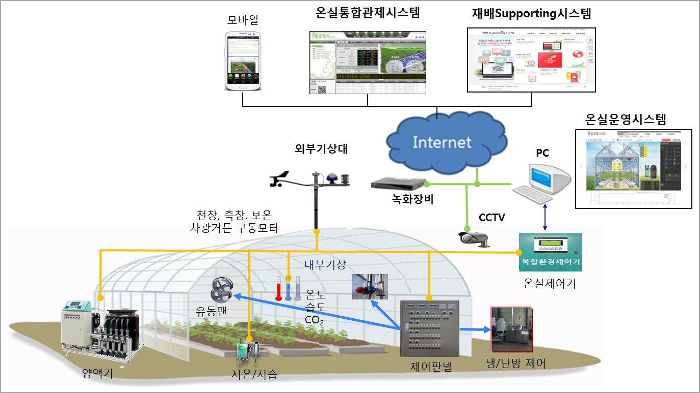
Smart Farm

Slide 7
Why? When?
It is to increase production and grow high quality agricultural products by controlling the environment appropriately.
It’s not against the eco-friendly environment nor violates agricultural values
Greenhouse
Horticulture
It’s not a matter of facility level (smart farming technology is needed anywhere such as in bare soil, plastic & glass green house)
Smart farming technology is required for the greenhouse horticulture format which has been heavily invested.
Smart Farming
Light : covering materials, curtains, shades
Temperature : ventilation technology, warming system
Humidity: research and diligence needed
CO2 : low cost but big effect
Nutrient solution : daily check, sensor management
Introduction of a smart farm solution should
be the last consideration .
Management
Requirements
Priority in order
(investment, management)

Slide 8
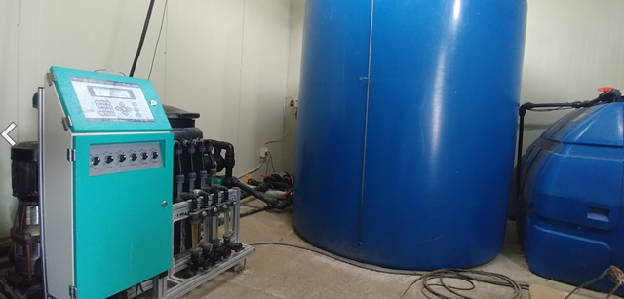
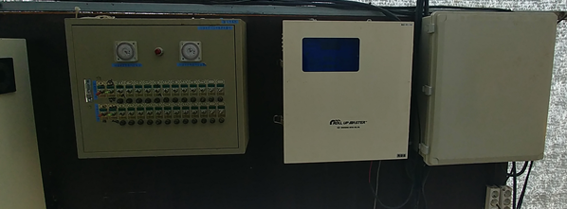
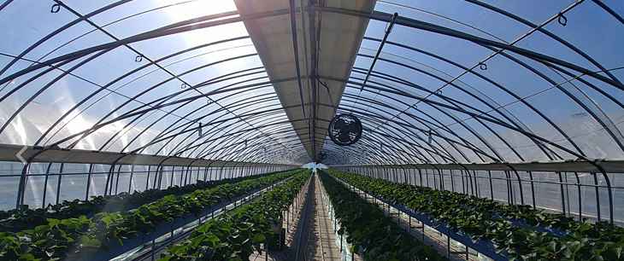
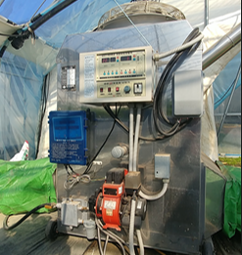
Employment of Smart Farm
Automated facility in 2014
(Single span green house)
Automated facility (Irrigation system, ventilation system)
Multilayer insulating curtains
Air agitator
Fan heater

Slide 9
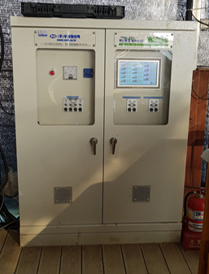
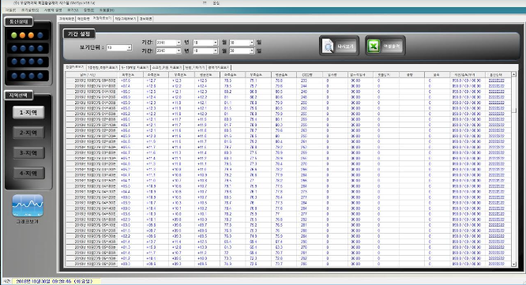
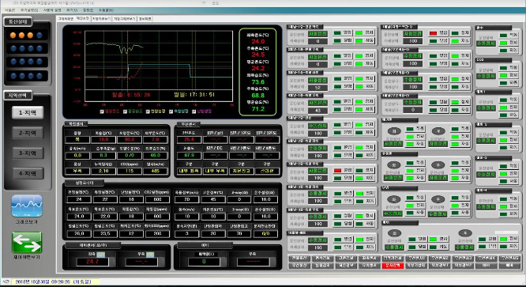
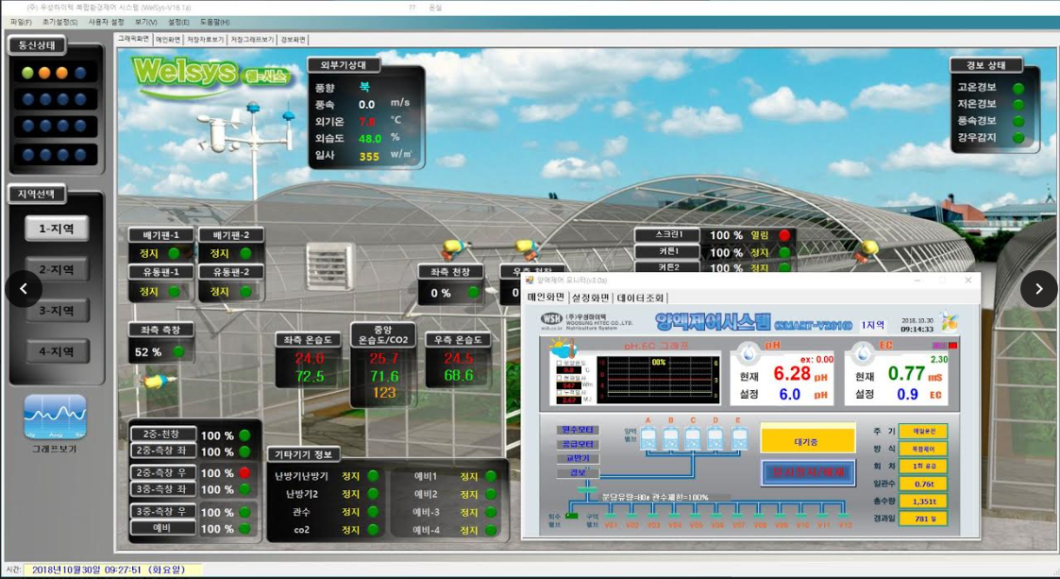
Employment of Smart Farm
Smart farm was introduced in 2016
(Multi span green house)
When building up a multi span green house, the smart farm solution was employed.
Incorporated control box was introduced.
CCTV was applied.
Remote control through PC and smart phones

Slide 10
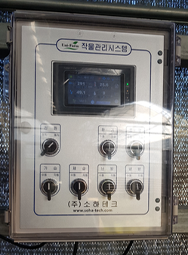
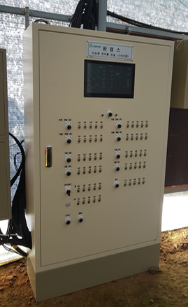
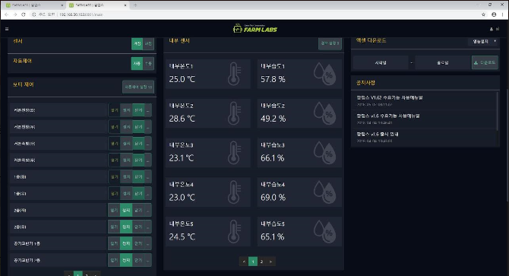
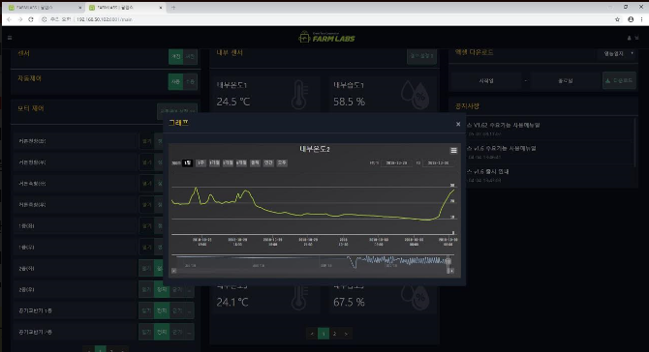
Employment of Smart Farm
Smart farm was expanded in 2018
(single span greenhouse)
CO2 supplier was installed.
The farming environment was optimized for strawberry raising (single span green house)
MOU with a solution vendor ➔ Test bed provided, requirements proposed & advisory to vendor
Legacy system incorporated
Environmental data accumulated
We are now in the process of studying smart farming tech
at the circulation/logistics level.

Slide 11
Effects of Smart Farm Employment
Productivity Hike
Cost saving
Convenience and etc.
Labor force reduced (2 permanent employees for 9,000m²)
Possibility for business expansion - Production of Processed goods and farm tour operated in parallel
- Acceleration of business scale
Quality life improved
Production quantity surged by 33% (4.5kg/m²→ 6kg/m²)
Average fruit weight rose by 15%
High proportion of A+ grade strawberry ➔
total revenue increased
Simple environment management
Data analysis ➔ farming technology advanced

Slide 12
Things That Would Have Been Improved
Standardization, Compatibility
High cost
Understanding depth on Agriculture
Direction of BIG DATA discussion
Payment for farmer’s knowledge and experience
Focus on REAL VALUE!!

Slide 13
Suggestions
To establish policy goals & output images by country first - Disseminate green house horticulture method ➔ Nutrient solution system ➔ Automated facility (control box) ➔ low-end smart farm system ➔ next generation’s smart farm
To identify smart farming technology tasks fitting for farming conditions and the level of technology - Crops vs. fruits vs. vegetables - Bare soil cultivation vs. greenhouse cultivation - Crops grown at high temp. vs. crops grown at low temp.
Legacy system, standardization & interoperability
Bench mark
To consider ways of advisory & partnership
To set up a business ecosystem in consideration of each player’s needs

Slide 14
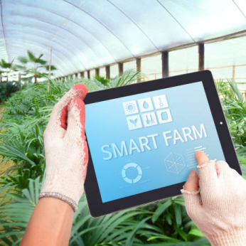
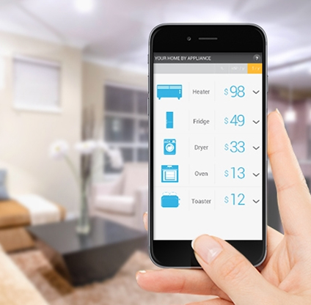
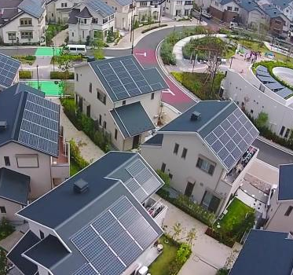
Future Strategy
What values can be brought to the rural area and the agriculture industry?
Productivity
Automation (Labor)
Intelligence (AI)
Convenience
(IoT, ICT, Mobile)
Convergence
Low-cost Energy
Eco-friendly
Smart Farm
Smart Home
Smart Town
Geothermal cooling & heating system for the agricultural industry, photovoltaics (PV), insulation materials, low temp. storage house/freezer, LED light source, agricultural robots, agricultural work vehicles (EV), drones, image devices (for monitoring), nutrient solution facility, various sensor, multiplex environment control system/solution
0

Slide 15
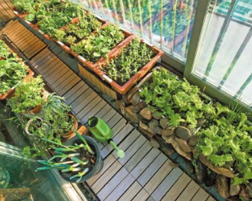
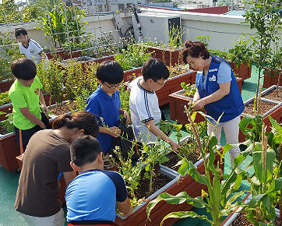
Future Strategy
How can we deliver the joy of life creation(agriculture) to citizens?
Weekend farm
I produce what I eat.
Bring green to house!
Like farmers, I…..
I am also a life creator.
Veranda Farm
Home Farm
School Farm
0
Home hydroponic system (strawberries, cherry tomatoes, leaves for Korean food Ssam, home farm applications, cultivation class, seedling, fertilizer for hydroponic system

Slide 16
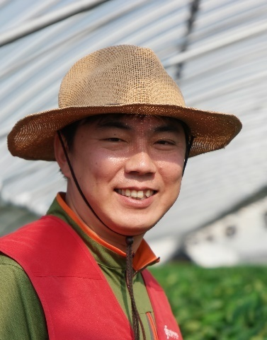
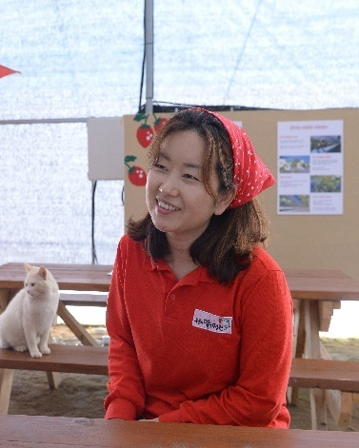
Bio of Top mgmt.
Honghee Park / CEO Farmer
Tel: 010-3010-0252
E-mail: ppakong@gmail.com
Yeonmee Kwak / Tour Director
Tel: 010-3011-0252
E-mail: Sean_jeanne@naver.com
’05 MBA, KAIST
‘97 BS, Communication in Yonsei Univ.
’06 MBA, KAIST
’96 BS, Communication in Yonsei Univ.
’14~Present Farmer in Woo-Gong’s Strawberry Garden
CEO of Good Farmer’s Group Inc.
’18 Chairman of Job Committee of North
Gyeongsang Province
’15 ~’17 Director General of Strawberry farmers
Association of North Gyeongsang Province
’08~’14 LGE, CSO Department HQ of LG Electronics
(Biz. development, M&A)
Director of Smart TV Planning/Operation
’97~’08 KTF, Manager of Global Biz., New Biz., PR
’17~ Present TouriDure PD of Ministry of Culture, Sport and Tourism
‘15~ Present Tour Director of Woo-Gong’s
Strawberry Garden
Auditor of Good Farmer’s Group Inc.
’06~’15 Director of Global Marketing Group,
Samsung Electronics
’96~’04 Manager of Technical Writing Group,
Samsung Electronics

